Slide 1
CSCE 587 Intro to R/Rstudio Part 1
John R. Rose
Computer Science and Engineering
University of South Carolina

Slide 2
Intro to R/RStudio
R and Rstudio are available for Linux, Mac OS, and Windows
You might consider installing R and Rstudio on your local machine.
R can be downloaded from: http://mirrors.nics.utk.edu/cran/
Rstudio can be downloaded from: http://www.rstudio.com/ide/download/desktop

Slide 3
Intro to R/RStudio
R is a programming language/environment
Object oriented
Rich set of packages (why reinvent the wheel?)
Good online help
RStudio is an IDE for R

Slide 4
Intro to R/RStudio
Variables – creating and evaluating
Vectors- creating and sub-setting
Matrices – creating and sub-setting

Slide 5
Creating variables
Use an assignment operator to assign a value to a variable.
# Using the “=“ assignment operator
> a = 7
Using the “<-” assignment operator
> b <- 3
Retrieve the values for a and b
> a
[1] 7
> b
[1] 3

Slide 6
Vectors
Vector – 1D sequence of elements of the same type
Create using:
concatenation c(), e.g. > fib = c( 1, 2, 3, 5, 8)
sequence seq(), e.g. > d = seq(from=1, to=5, by=0.5)
repeated val rep(), e.g. > e = rep(7, 3)

Slide 7
Vectors: Some built-in functions
Length, e.g.
> length(d)
[1] 9
Max, e.g.
> max( fib )
[1] 8
Min, e.g.
> min( fib )
[1] 1
Average, e.g.
> mean( fib )
[1] 3.8

Slide 8
Subsetting Vectors
What if we only want a single element of a vector?
Use a sub-setting operation!
What if we want more than a single element but not all elements?
Use a sub-setting operation!

Slide 9
Subsetting Vectors
How do we access the ith element?
Use [i] to access the ith element (indices start with 1)
Example: access the 3rd element of fib:
> fib[3]
[1] 3
How do we access only elements 2 through 5?
> fib[2:5]
[1] 2 3 5 8

Slide 10
Subsetting Vectors
How do we access everything BUT the ith element?
Use [-i] to exclude the ith element (indices start with 1)
Example: exclude the 3rd element of fib:
> fib[-3]
[1] 1 2 5 8
How do we exclude only elements 2 through 4?
> fib[-(2:4)]
[1] 1 8

Slide 11
Subsetting Vectors
What if we want only the second and forth elements?
Use a vector as selection argument
Example: access the 2nd and 4th elements of fib:
> x=c(2,4)
> fib[x]
[1] 2 5
Can we return them in reverse order?
> y=c(4,2)
> fib[y]
[1] 5 2

Slide 12
Subsetting Vectors
What if we want to EXCLUDE the second and forth elements?
Use a vector as a deselection argument
Example: exclude the 2nd and 4th elements of fib:
> x=c(2,4)
> fib[-x]
[1] 1 3 8
Note: excluding in reverse order gives the same answer.
> y=c(4,2)
> fib[-y]
[1] 1 3 8

Slide 13
Subsetting Vectors
We can get all of vector fib in reverse order by specifying the indices in reverse
How many elements in fib?
> length(fib)
[1] 5
Can we use the seq() operator to create a vector with the indices in reverse order?
Recall seq() operator: seq(from=x1, to=x2, by=x2)

Slide 14
Subsetting Vectors
Recall seq() operator: seq(from=x1, to=x2, by=x2)
Let x1 = length of fib
Let x2 = 1
Let x3 = -1 (we’re counting down)
> seq(from=length(fib), to=1, by=-1)
[1] 5 4 3 2 1

Slide 15
Subsetting Vectors
Now put it altogether:
> fib[seq(from=length(c), to=1, by=-1)]
[1] 8 5 3 2 1

Slide 16
Testing to Subset Vectors
We can also test elements in a vector.
Example: which elements have the value 1?
> fib==1
[1] TRUE FALSE FALSE FALSE FALSE

Slide 17
Testing to Subset Vectors
What about those elements that are not 1?
Example: which elements which do not have the value 1?
> fib!=1
[1] FALSE TRUE TRUE TRUE TRUE

Slide 18
Testing to Subset Vectors
Can we get the indices of the elements that evaluate true?
Yes, use which()
Example:
> which(fib==8)
[1] 5
Compare:
> fib==8
[1] FALSE FALSE FALSE FALSE TRUE

Slide 19
Testing to Subset Vectors
How can we use which() to find the index of the largest element of fib?
Example:
> which(fib==max(fib))
[1] 5
Compare:
> fib==max(fib)
[1] FALSE FALSE FALSE FALSE TRUE
Could also use which.max(fib) to find the index of the largest element

Slide 20
Matrices
A matrix in R is like a 2D vector: all elements must be of the same type
Creating matrices: use the matrix() function
matrix(data, nrow =, ncol=, byrow=)
Example:
> m = matrix(5:10, nrow=3, ncol=2, byrow=F); m
[,1] [,2]
[1,] 5 8
[2,] 6 9
[3,] 7 10

Slide 21
Manipulating Matrices
Transposition: use the t() operator
> t(m)
[,1] [,2] [,3]
[1,] 5 6 7
[2,] 8 9 10

Slide 22
Manipulating Matrices
Multiplication: %*% operator
> m %*% t(m)
[,1] [,2] [,3]
[1,] 89 102 115
[2,] 102 117 132
[3,] 115 132 149
If we use the * operator, we get pairwise multiplication instead
> m * m
[,1] [,2]
[1,] 25 64
[2,] 36 81
[3,] 49 100

Slide 23
Manipulating Matrices
Use dim() to get dimensions
> dim(m)
[1] 3 2
Alternatively retrieve number of columns and rows seperately.
> nrow(m)
[1] 3
> ncol(m)
[1] 2

Slide 24
Subsetting Matrices
To get a specific element specify the row and column
> m[1,1]
[1] 5
How do we get an entire row? Specify the row, but not the column
> m[1,]
[1] 5 8
Similarly, we can get an entire column
> m[,1]
[1] 5 6 7

Slide 25
Subsetting Matrices
We can also create a vector specifying which rows/columns we want
> m[c(1,3),]
[,1] [,2]
[1,] 5 8
[2,] 7 10
This returns the 1st and 3rd rows
We can also return those rows in a different order
> m[c(3,1),]
[,1] [,2]
[1,] 7 10
[2,] 5 8

Slide 26
Subsetting Matrices
Similarly we can use a vector specifying which rows/columns we want to exclude
> m[-c(1,3),]
[1] 6 9
This returns the only the 2nd row
We can also return those rows in a different order
> m[c(3,1),]
[,1] [,2]
[1,] 7 10
[2,] 5 8

Slide 27
Subsetting Matrices
Can also use which() with matrices
> which(m==max(m))
[1] 6
Similarly which.max(m)
Question? m is a 3 by 2 matrix. What is 6?
Note: m[3,2] == m[6]
So m[which.max(m)] returns the largest element

Slide 28
Matrices from vectors
Vectors can be used to create matrices
Treat the vectors as rows in a matrix using rbind()
> rm <- rbind(fib,fib,fib)
> rm
[,1] [,2] [,3] [,4] [,5]
fib 1 2 3 5 8
fib 1 2 3 5 8
fib 1 2 3 5 8

Slide 29
Matrices from vectors
Or combine vectors as columns using cbind()
> cm <- cbind(fib,fib,fib)
> cm
fib fib fib
[1,] 1 1 1
[2,] 2 2 2
[3,] 3 3 3
[4,] 5 5 5
[5,] 8 8 8

Slide 30
Exercise (borrowed from Irina Kukuyeva)
Problem: return the sum of the even rows of column 2 of a 10X10 matrix. The matrix contains the values 1 to 100 in row order.
Step 1: create the matrix
Recall: matrix(data, nrow =, ncol=, byrow=)
> ex1 = matrix(1:100, nrow=10, ncol=10, byrow=T)

Slide 31
Exercise (borrowed from Irina Kukuyeva)
Problem: return the sum of the even rows of column 2 of a 10X10 matrix. The matrix contains the values 1 to 100 in row order.
Step 2: Figure out how to specify the even rows?
Could hard code the rows, i.e. c(2,4,6,8,10) Ugly!!!!
Try to use seq() instead!
seq(from=2, to=10, by=2) still not great, but better

Slide 32
Exercise (borrowed from Irina Kukuyeva)
Problem: return the sum of the even rows of column 2 of a 10X10 matrix. The matrix contains the values 1 to 100 in row order.
Step 3: use step2 to select the even rows
> ex1[seq(from=2, to=10, by=2),]
[,1] [,2] [,3] [,4] [,5] [,6] [,7] [,8] [,9] [,10]
[1,] 11 12 13 14 15 16 17 18 19 20
[2,] 31 32 33 34 35 36 37 38 39 40
[3,] 51 52 53 54 55 56 57 58 59 60
[4,] 71 72 73 74 75 76 77 78 79 80
[5,] 91 92 93 94 95 96 97 98 99 100

Slide 33
Exercise (borrowed from Irina Kukuyeva)
Problem: return the sum of the even rows of column 2 of a 10X10 matrix. The matrix contains the values 1 to 100 in row order.
Step 4: use step 3 to select the even rows AND only column 2
> ex1[seq(from=2, to=10, by=2), 2]
[1] 12 32 52 72 92
Recall ex1:
[,1] [,2] [,3] [,4] [,5] [,6] [,7] [,8] [,9] [,10]
[1,] 1 2 3 4 5 6 7 8 9 10
[2,] 11 12 13 14 15 16 17 18 19 20
[3,] 21 22 23 24 25 26 27 28 29 30
[4,] 31 32 33 34 35 36 37 38 39 40
[5,] 41 42 43 44 45 46 47 48 49 50
[6,] 51 52 53 54 55 56 57 58 59 60
[7,] 61 62 63 64 65 66 67 68 69 70
[8,] 71 72 73 74 75 76 77 78 79 80
[9,] 81 82 83 84 85 86 87 88 89 90
[10,] 91 92 93 94 95 96 97 98 99 100

Slide 34
Exercise (borrowed from Irina Kukuyeva)
Problem: return the sum of the even rows of column 2 of a 10X10 matrix. The matrix contains the values 1 to 100 in row order.
Step 5: use sum() to sum vector produced in step 4
> sum(ex1[seq(from=2, to=10, by=2),2])
[1] 260

Slide 35
Loading Data Sets
Several ways to load data sets
Data sets in R packages
Data sets from the web
Data sets on the VM

Slide 36
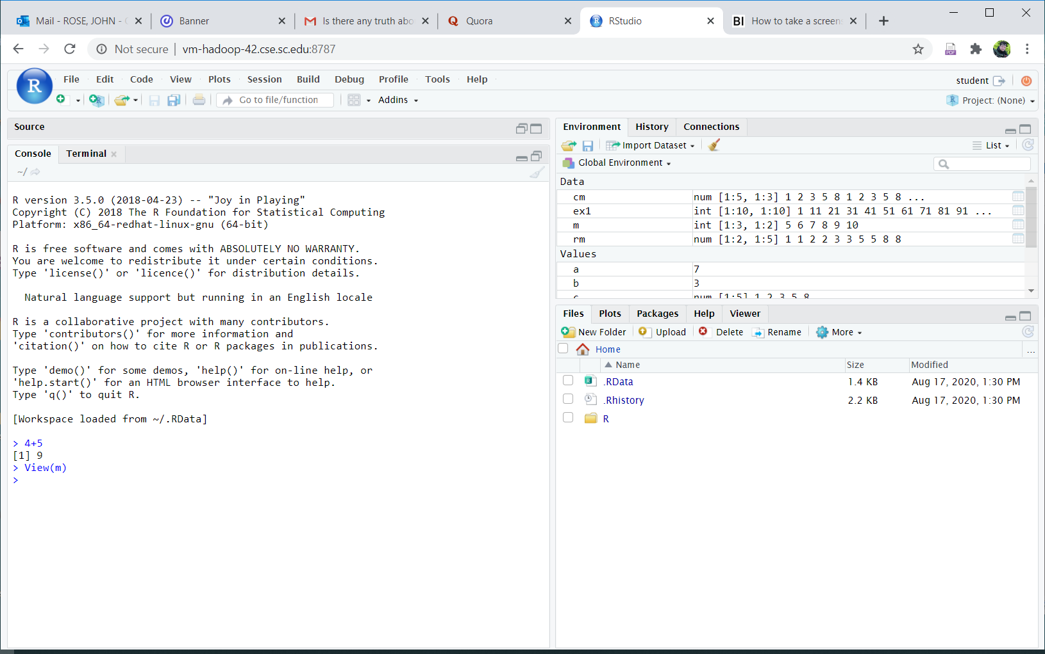
Loading Data Sets from R Packages
Let’s start by examining the Rstudio interface

Slide 37
Loading Data Sets from R Packages
Click on the Packages button
The second package listed is alr3
Click in the box preceeding it to load the package
Did you notice that when you clicked, text appeared in the console window?
That text is actual load command issued from Rstudio to R to cause the alr3 package to be loaded.

Slide 38
Loading Data Sets from R Packages

Slide 39
Loading Data Sets from R Packages
Use data() to access the UN2 data set in the alr3 package
> data(UN2)
> UN2
logPPgdp logFertility Purban
Afghanistan 6.614710 2.7655347 22
Albania 10.363040 1.1890338 43
Algeria 10.800900 1.4854268 58
Angola 9.529431 2.8479969 35
Argentina 12.806348 1.2868811 88
Armenia 9.424166 0.2016339 67
Australia 14.197524 0.7655347 91
Austria 14.505563 0.3561438 67

Slide 40
Working with Data Sets
We’ll examine other ways of loading data sets later
Let’s look at working with the UN2 data set
This data set looks like a matrix with row and column labels
Let’s examine the first row:
> UN2[1,]
logPPgdp logFertility Purban
Afghanistan 6.61471 2.765535 22
Note: R shows us the row and column labels in the output

Slide 41
Working with Data Sets
Row and Column labels are more than just nice
They can be used to for subsetting
> UN2['Algeria',]
logPPgdp logFertility Purban
Algeria 10.8009 1.485427 58
This is MUCH better than hard coding an index.
Consider what happens if the new country Aardvarklandia is added:
Algeria’s numerical index will change!

Slide 42
Working with Data Sets
We can easily calculate the mean for each column:
> mean(UN2[,'logPPgdp'])
[1] 10.99309
> mean(UN2[,'logFertility'])
[1] 1.468687
> mean(UN2[,'Purban'])
[1] 55.53886

Slide 43
Working with Data Sets
Since this is a matrix, we can compute the variance-covariance:
> var(UN2)
logPPgdp logFertility Purban
logPPgdp 5.640839 -1.2475279 44.55587
logFertility -1.247528 0.6009038 -11.00879
Purban 44.555873 -11.0087939 579.19770

Slide 44
Data Sets from the Web
The url of our data set is:
https://cse.sc.edu/~rose/587/WavesBasicR.RData
This is binary data file
We need to download to the vm
Select the Terminal window in Rstudio and enter:
wget https://cse.sc.edu/~rose/587/WavesBasicR.RData

Slide 45
Excerpt from Terminal window showing command and result
[student@sandbox-host ~]$ wget https://cse.sc.edu/~rose/587/WavesBasicR.RData
--2020-08-18 14:31:30-- https://cse.sc.edu/~rose/587/WavesBasicR.RData
Resolving cse.sc.edu (cse.sc.edu)... 129.252.138.12
Connecting to cse.sc.edu (cse.sc.edu)|129.252.138.12|:443... connected.
HTTP request sent, awaiting response... 200 OK
Length: 1472151 (1.4M)
Saving to: ‘WavesBasicR.RData’
100%[===========================================>] 1,472,151 --.-K/s in 0.01s
2020-08-18 14:31:30 (98.6 MB/s) - ‘WavesBasicR.RData’ saved [1472151/1472151]

Slide 46
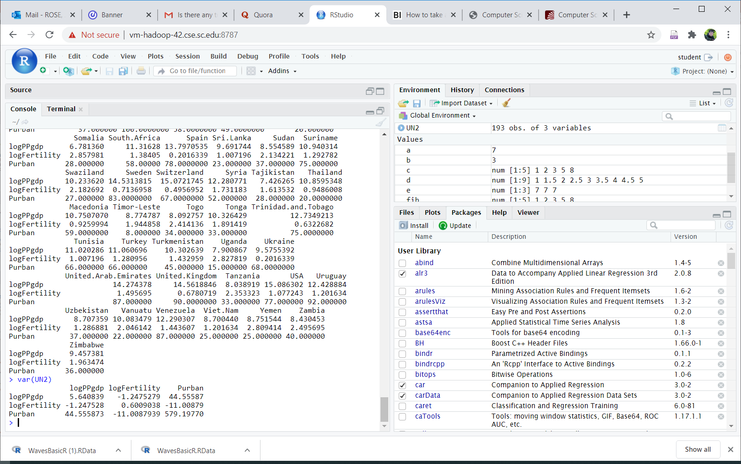
Data Sets from the Web
Now we can load the data set into RStudio
Click on the load workspace icon

Slide 47
Result of clicking on “load workspace” icon

Slide 48
Click on WavesBasicR.Rdata entry in the popup
Click on the open button in the popup
You’ll see this line appear in the console window:
> load("~/WavesBasicR.RData")
The data set is a matrix called “data”
If you click on the “environment” tab you’ll see it has 80072 rows

Slide 49
Environment Tab

Slide 50
Exercise (borrowed from Irina Kukuyeva)
Using this data set, how many waves are higher than the mean height?
Let’s start by looking at the first few rows of data
> data[1:10,]
y x wave_height
15 -66.13506 18.82452 5.408
30 -66.09778 20.76402 5.053
45 -66.03464 22.69563 4.663
60 -65.94584 24.61539 4.937
75 -65.83165 26.51951 4.653
90 -65.69244 28.40436 4.765
105 -65.52863 30.26658 4.370
120 -65.34071 32.10304 4.299
135 -65.12923 33.91093 4.066
150 -64.89478 35.68771 3.682

Slide 51
Exercise (borrowed from Irina Kukuyeva)
Note: the third column is the wave height
1. Start by calculating the mean (use the column label)
> mean(data[,'wave_height'])
[1] 4.841396
2. Determine “which” observations are larger than the mean?
Hint: use which() and save the resulting vector
> larger = which(data[,'wave_height']>mean(data[,'wave_height']))
3. Get length of vector. This is our answer!
> length(larger)
[1] 29662

Slide 52
End of Intro to R-Rstudio Part 1

